Slide 1

HUM103 Group presentation
Environment
Ethics
Presenters: Naimul Islam ( ID:21201020 )
Ahtesham Ibne Mostafa (ID:21201342)

Slide 2
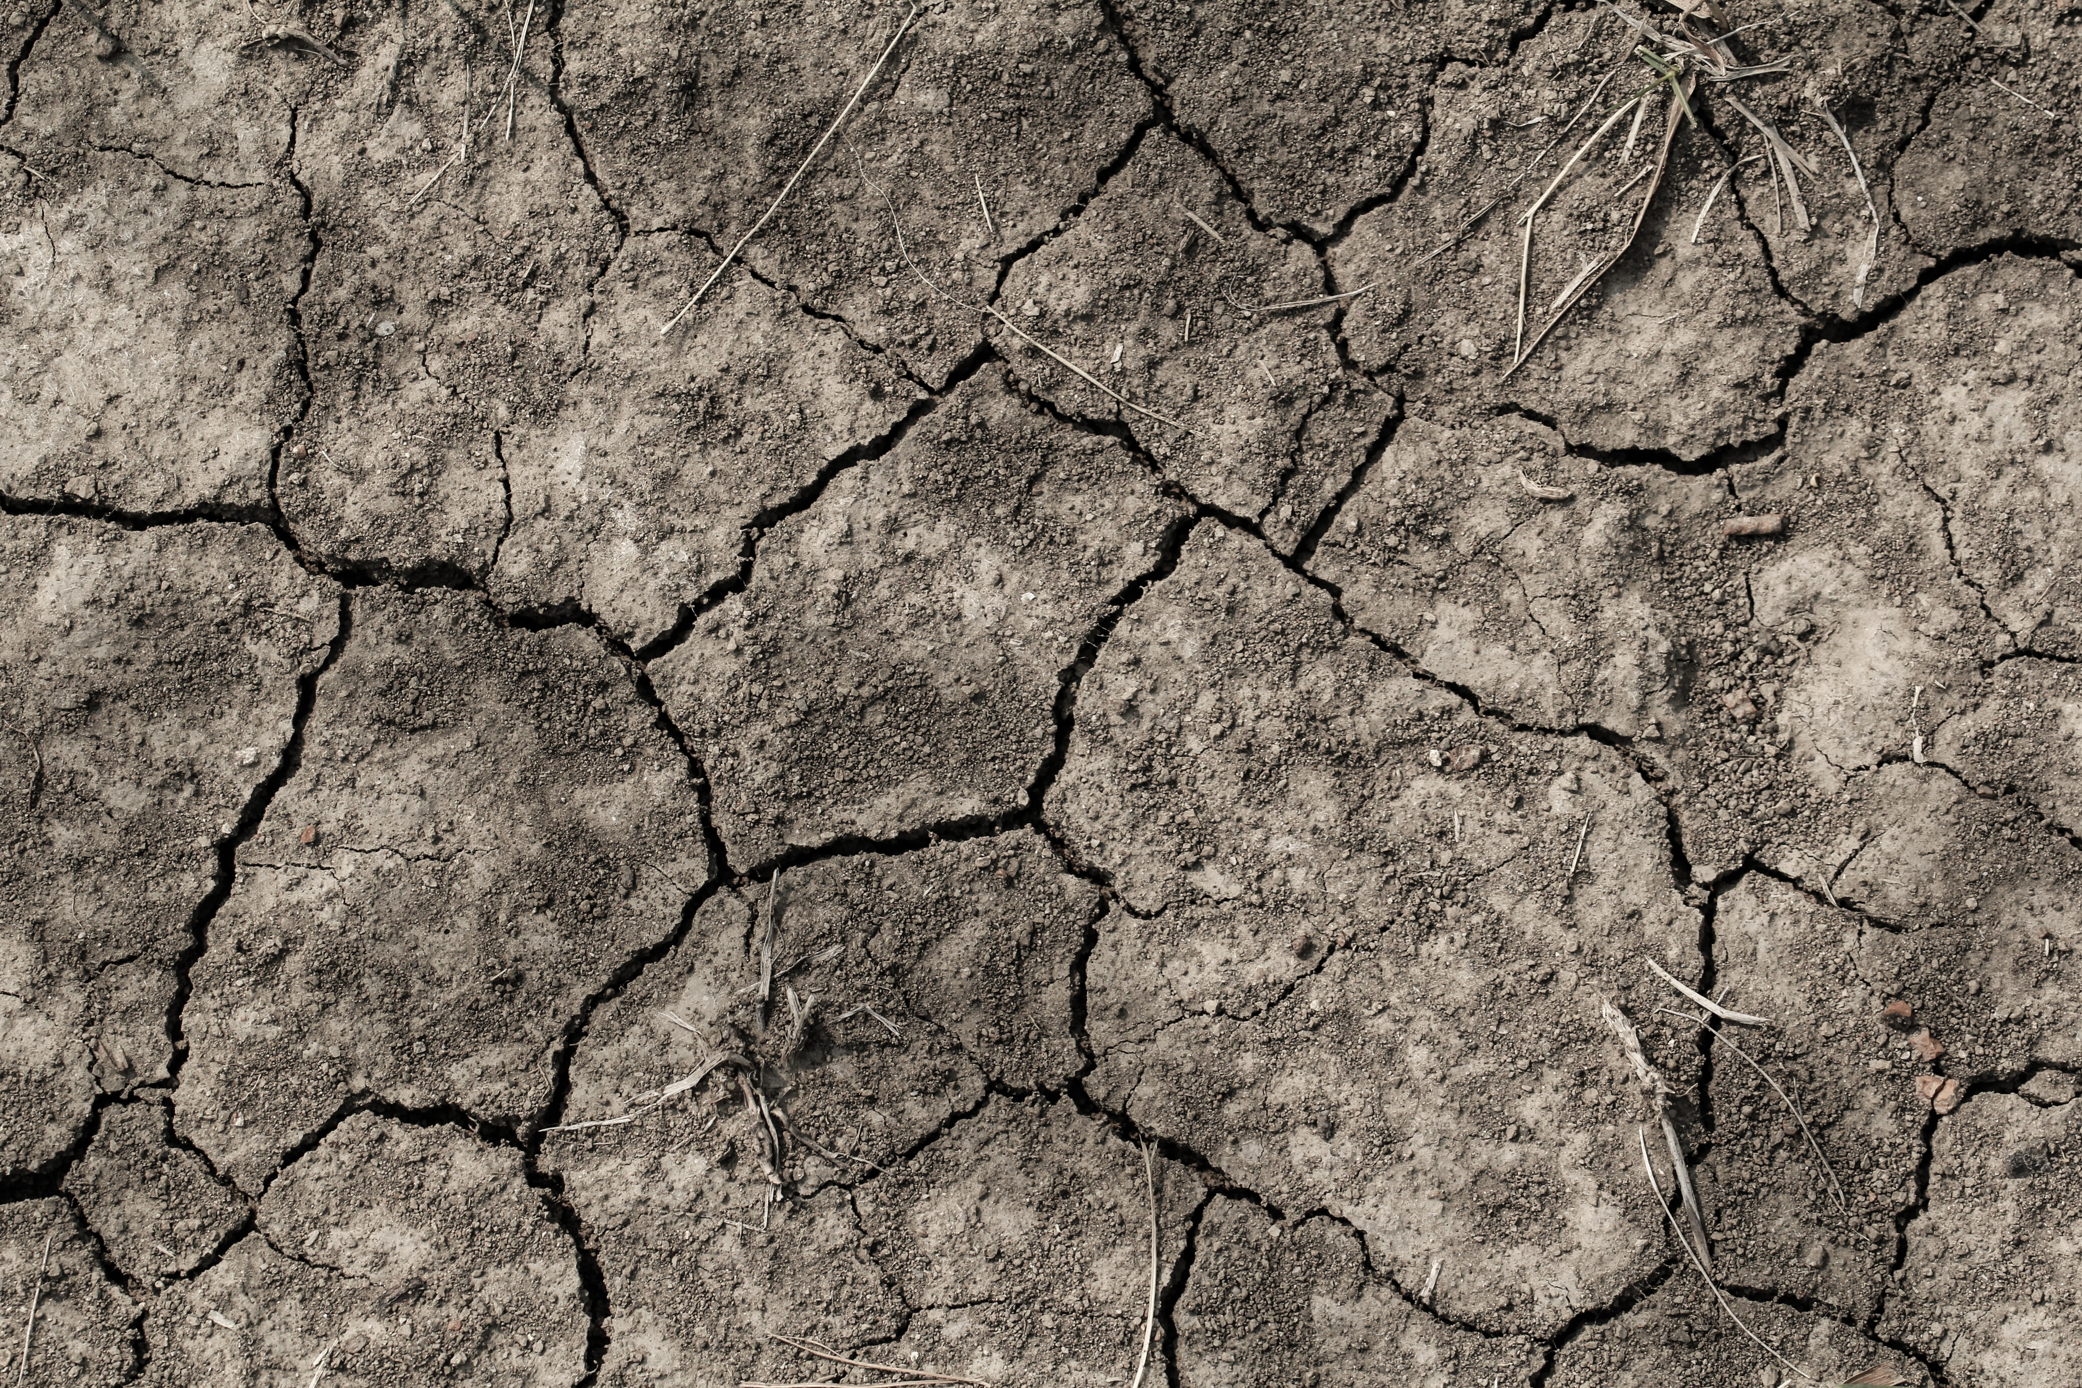
Overview
Environmental ethics is the discipline in philosophy that studies the
moral relationship of human being to, and also the value and moral status
of, the environment and its non human contents.
The development of environmental ethics was an important milestone,
which was introduced in the first Earth Day on April 22, 1970.
Environmental ethics developed primarily as a radical critique and
correction of anthropocentric ethics.

Slide 3
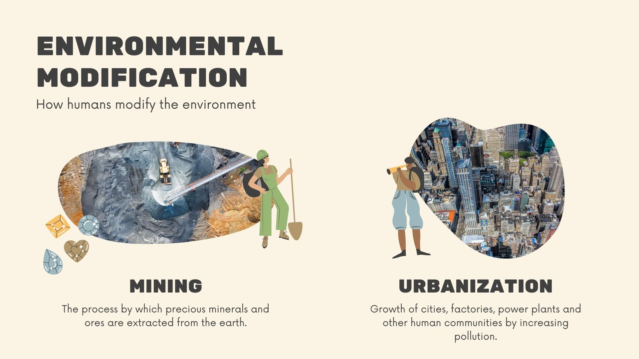

Slide 4
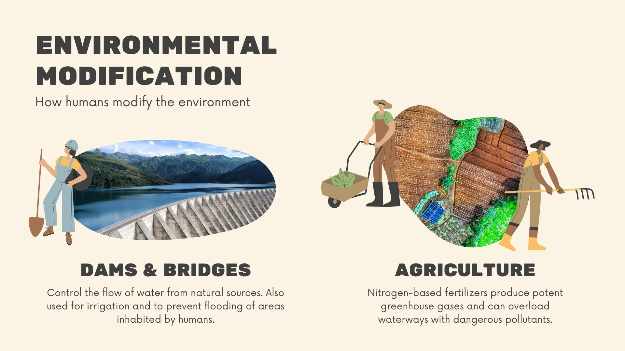

Slide 5
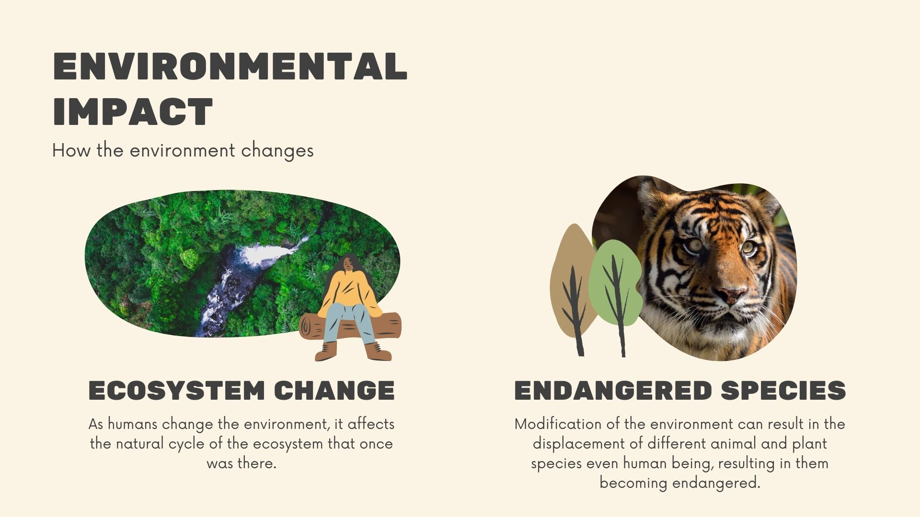

Slide 6
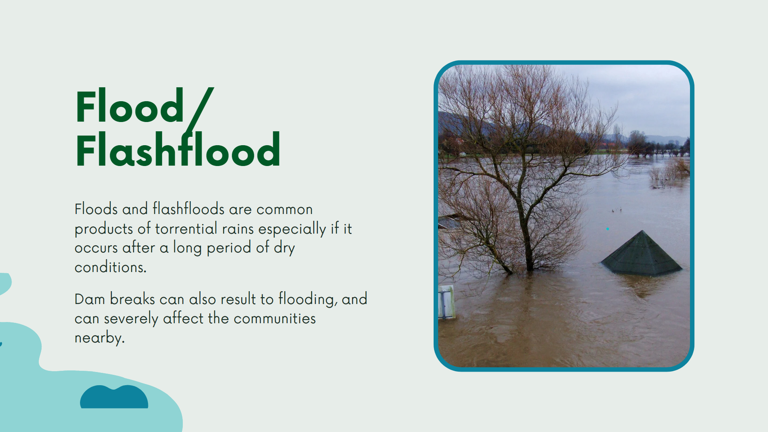

Slide 7
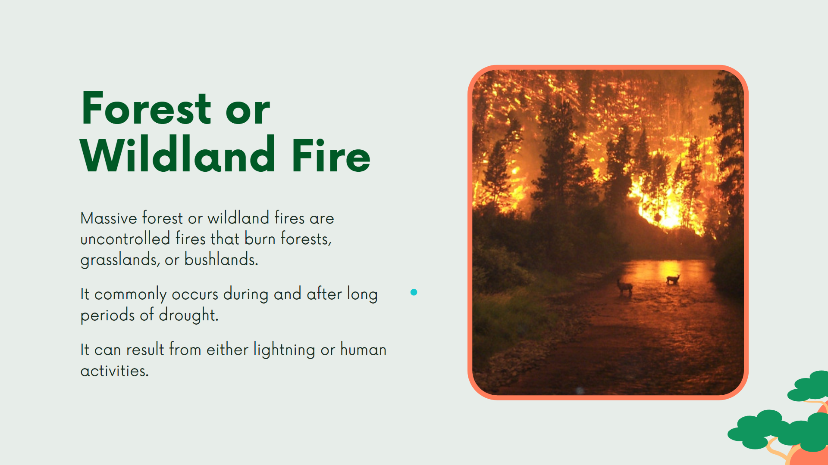

Slide 8
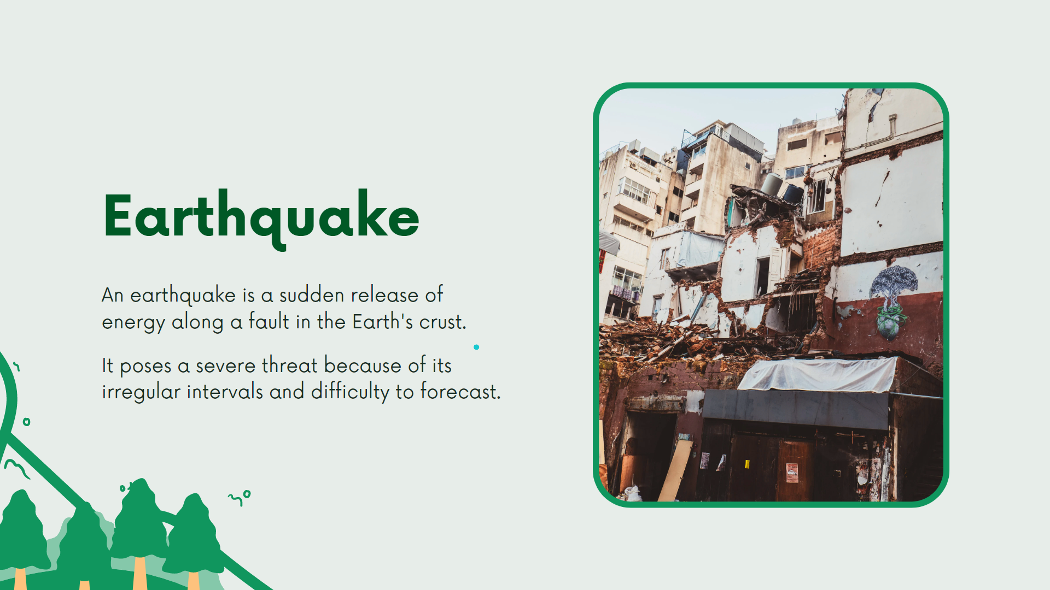

Slide 9
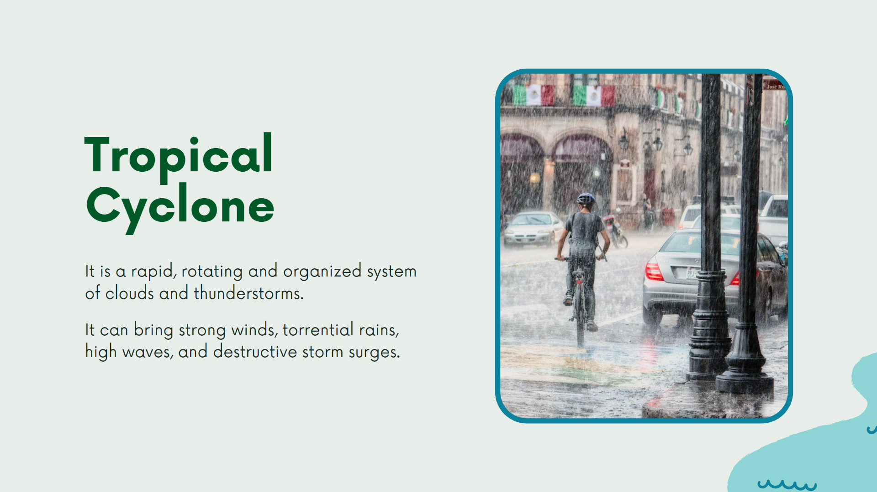

Slide 10
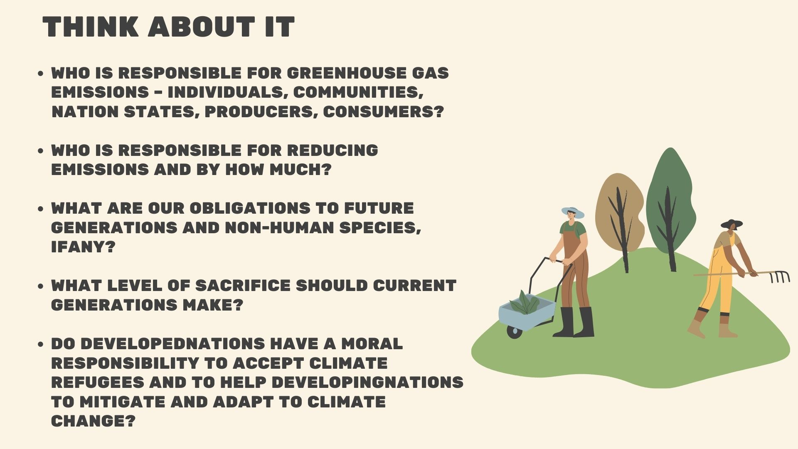

Slide 11
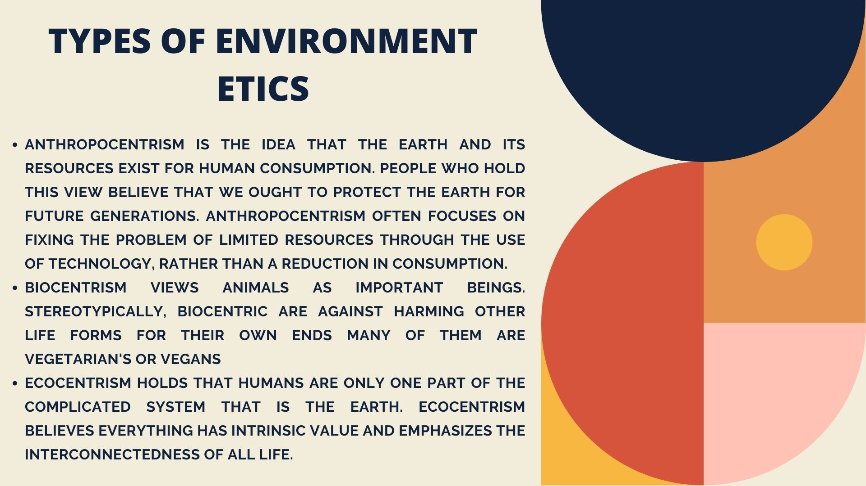

ETHICS

Slide 12
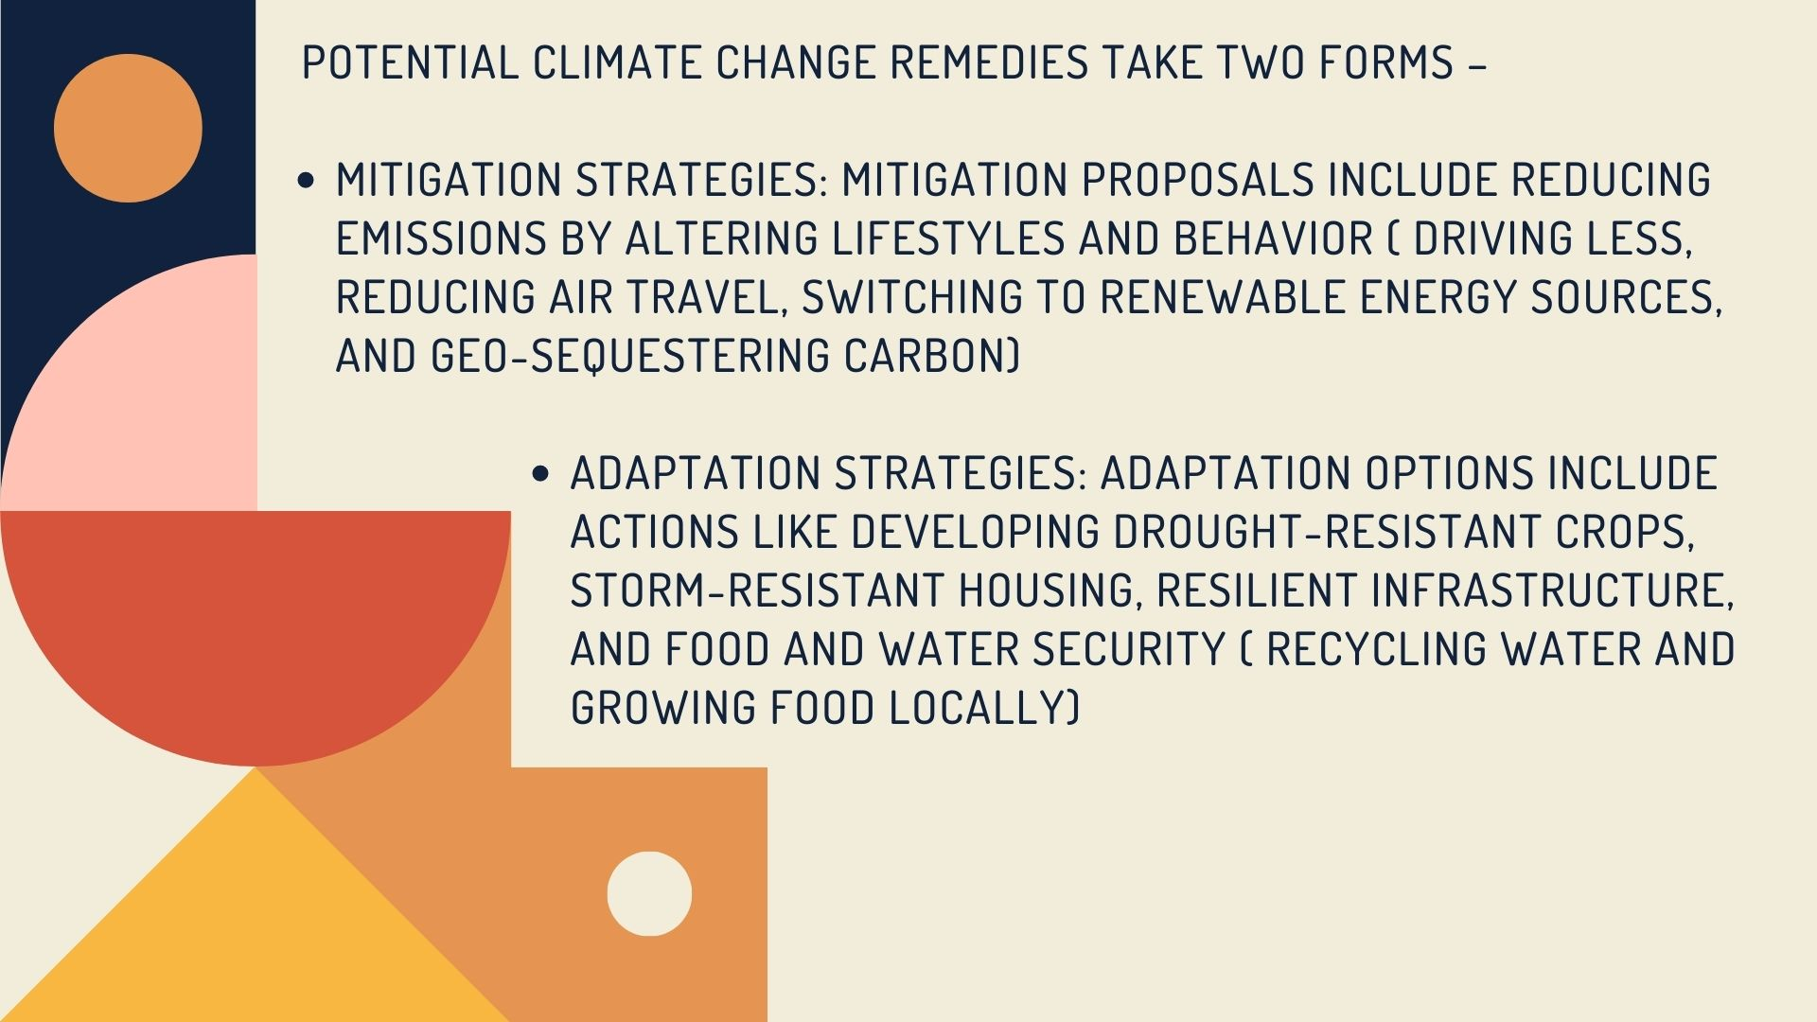

Slide 13
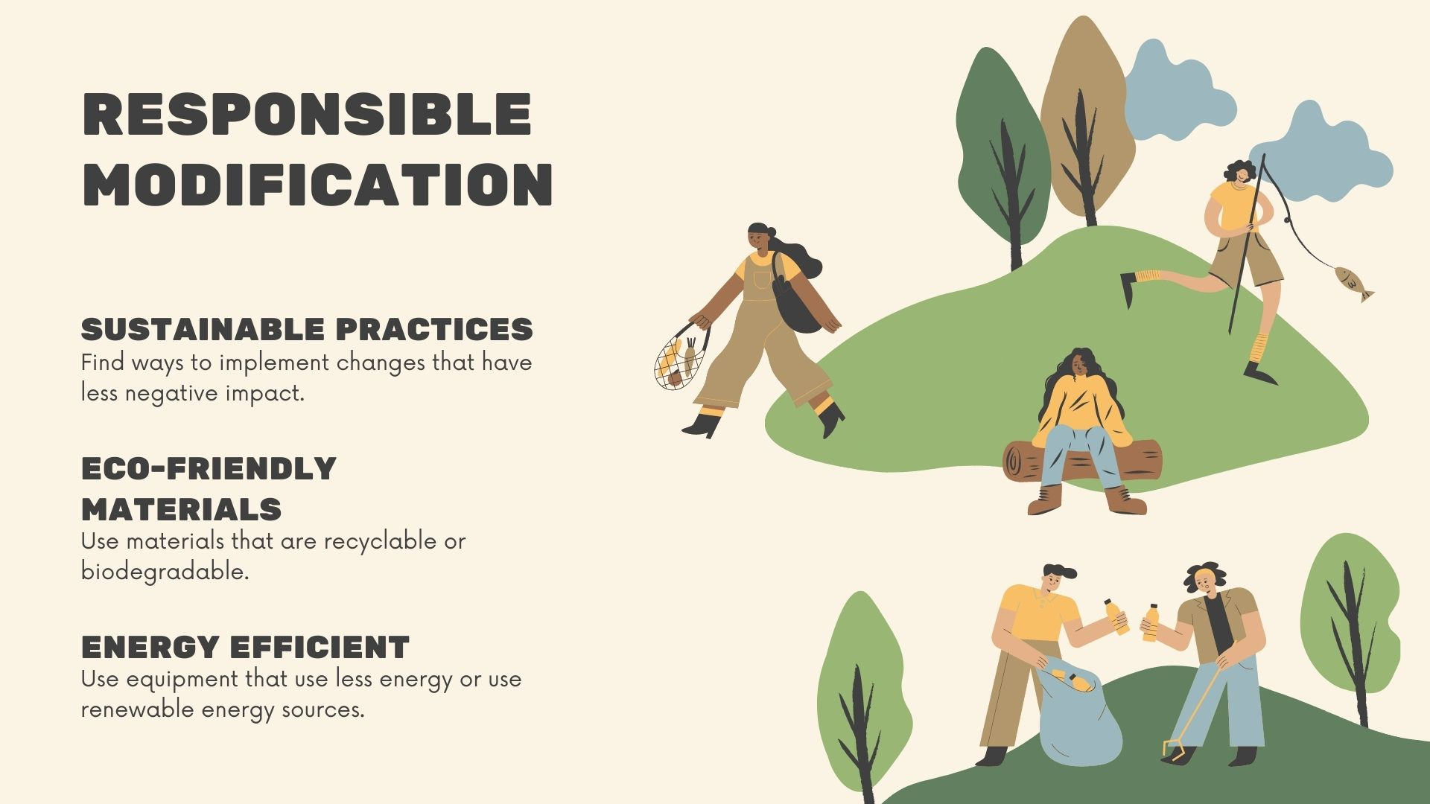

Slide 14
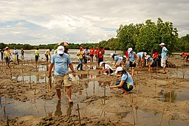




The ethical issues raised by climate change are complex. Clearly there is no one
single ethical position that will helps us to address all aspects of climate change
and its impacts. Moreover competing ethical positions can create paradoxes and
dilemmas. While there is a dire need for a globally agreed set of ethical principles
to address climate change, arriving at such an agreement will be fraught with
challenges. Few however, would disagree that we must find a more socio-
ecologically sustainable way of life.

Slide 15


